Slide 1
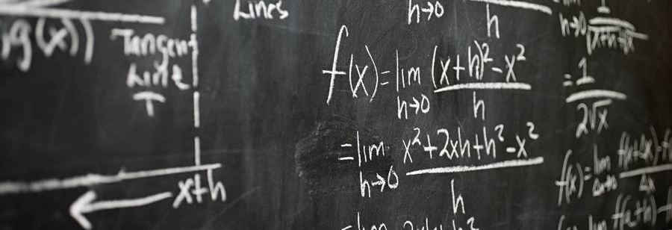
K Means Clustering
Dr Uday Pratap Singh

Slide 2
Cluster analysis
Cluster analysis is a multivariate statistical technique that groups observations on the basis some of their features or variables that they are described by.
“The goal of clustering is to maximize the similarity of observations within a cluster and maximize the dissimilarity between clusters.”

Slide 3
In practice, clustering helps identify two qualities of data:
Meaningfulness
Usefulness
Meaningful clusters expand domain knowledge. For example, in the medical field, researchers applied clustering to gene expression experiments. The clustering results identified groups of patients who respond differently to medical treatments.
Useful clusters, on the other hand, serve as an intermediate step in a data pipeline. For example, businesses use clustering for customer segmentation. The clustering results segment customers into groups with similar purchase his histories, which businesses can then use to create targeted advertising campaigns.

Slide 4
Euclidean distance
The most intuitive way to measure the distance between them is by drawing a straight line from one to the other. Popularly known as Euclidean distance.

Slide 5
Conventional k-means requires only a few steps. The first step is to randomly select k centroids, where k is equal to the number of clusters you choose. Centroids are data points representing the center of a cluster.
The main element of the algorithm works by a two-step process called expectation-maximization. The expectation step assigns each data point to its nearest centroid. Then, the maximization step computes the mean of all the points for each cluster and sets the new centroid. Here’s what the conventional version of the k-means algorithm looks like:

Slide 6
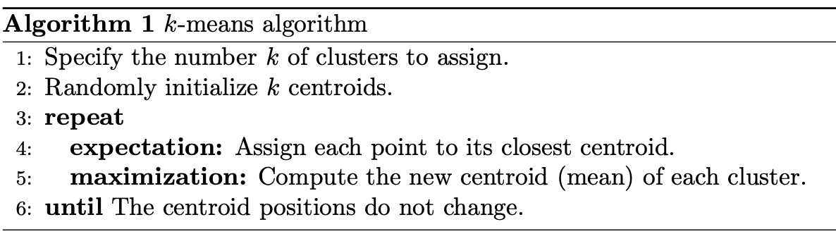

Slide 7
K-means Clustering

Slide 8
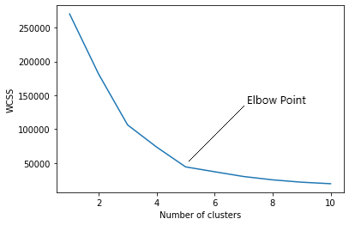
Finding the optimal number of clusters
Finding the optimal number of clusters is an important part of this algorithm. A commonly used method for finding optimal K value is Elbow Method.

Slide 9
K-means clustering -pros and cons

Slide 10
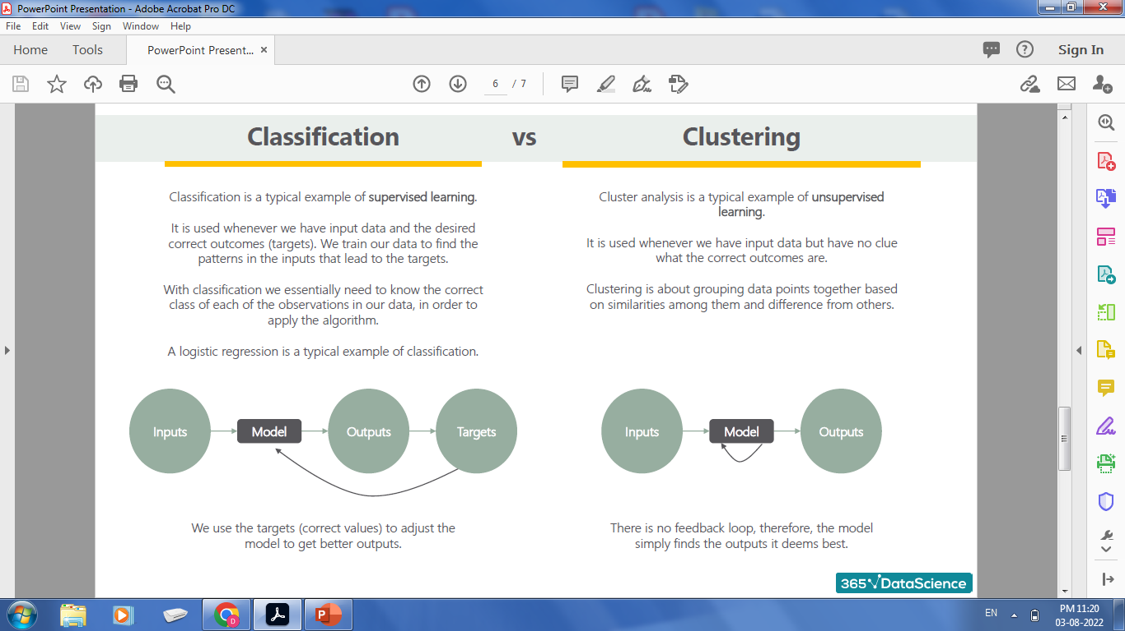

Slide 11
Thank You

